Slide 1
Wireless Security Overview
Security in a Mobile Environment
Rob Cole
Senior Account Manager
Symbol Technologies
Notes:
Brand Positioning
January 2004
Create new advantage with Symbol Technologies.
The Enterprise Mobility Company.
Symbol Technologies lets you to capitalize on the powerful, new advantages of the real-time enterprise — accelerating revenue growth, productivity, operational efficiency and productivity in the process.
Make faster, better decisions. Create a more streamlined supply chain. Empower managers and associates to do more with less. Enterprise Mobility Solutions from Symbol meet your business’ most essential needs.
That’s because only Symbol provides end-to-end Mobility Solutions that let you capture information in real time, right at the point of business activity. Move information instantaneously to and from the point of greatest impact. And manage the unimpeded flow of information with exceptional efficiency and security.
These comprehensive and integrated capabilities – called Cm2 -- represent all the key component parts of Enterprise Mobility. They are unique to Symbol Technologies and enabled by:
• Unrivaled knowledge of how Mobility Solutions can meet key needs – from better supply chain execution to enhanced service levels to increased patient safety
• Integrated mobility systems including advanced data capture devices, ruggedized mobile computers, and high-performance, secure wireless network infrastructure
• Comprehensive management tools and capabilities that address the uniquely dynamic nature of Mobility Solutions to optimize their performance
• A partner network with best-of-breed applications
• Symbol Enterprise Mobility Services — the premier service organization to unlock the value of mobility for your business through the deepest expertise in designing, implementing and supporting large-scale solutions
So whether providing retail sales associates with real-time customer data at the point of service, or giving supply chain managers greater inventory visibility, realize the new advantages of the real-time enterprise. With Symbol Technologies. The Enterprise Mobility Company.

Slide 2
Wireless Security Executive Overview

Slide 3
Security: How do we see it today?
Passwords on our computers, dialup numbers, and internet online accounts/account activity
Physical security/restrictions on access to a business’s or home’s wired network.
Access cards that let us into our schools, and office buildings for work.
Concerned: As we read about another credit card company or information processor, that had 100,000 customer Mastercard account numbers stolen.
Keys to our homes, cars. Finger prints? Voice?

Slide 4
What is the wireless ‘world’?
Handheld or larger devices that communicate through the air waves
They talk to ‘access points/access ports’, which are collectors of and initiators of communication through the airwaves. Access points: antenna, radio plus intelligence. Access port: no intelligence.
The access points/access ports are connected via cable to switches and then to the ‘wired network’ through the switches.
There are standards that describe how the packet of data is constructed, how fast it goes, how it is secured, and all of it data contents

Slide 5
Why is Wireless Security Different?
There is nothing to connect to (not really true as the access ports are connected to a switch and then to the network)
Adding or stealing an access point is not difficult.
Someone external, can ‘sniff’ your network without physically attaching to it, or even entering your facility.
There are many inexpensive commercial devices available that increase risk and ‘basic’ knowledge.

Slide 6
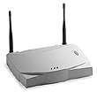
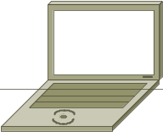
Developing a Wireless Security Policy
Propriety Wireless
802.11b Standard
Open
WEP
Companies were still compromised…
Companies were compromised…
Corporate Security Policy
Corporate Wireless Security Policy

Slide 7
Wireless Security Terms
Corporate Wireless Security Policy
MD5
WPA
WEP
VPN
EAP
IEEE
802.11i
TKIP
WiFi
TTLS
TLS
AES
FIPS-140
802.1x
PEAP
New and Confusing Terms

Slide 8
Wireless Security Terms
What do all the new terms mean…
IEEE - Institute of Electrical and Electronics Engineers
IETF - Internet Engineering Task Force
802.1x - Framework for Port based Authentication
Wi-Fi - Wireless Fidelity
WEP - Wired Equivalent Privacy
TKIP - Temporal Key Integrity Protocol
WPA - Wi-Fi Protected Access
EAP - Extensible Authentication Protocol
PEAP - Protected Extensible Authentication Protocol
FIPS - Federal Information Processing Standards
802.11i - Wireless Security Standard Draft
AES - Advanced Encryption Standard
VPN - Virtual Private Network
TLS - Transport Layer Security
TTLS - Tunneled Transport Layer Security

Slide 9


Definitions
Authentication
Encryption
“Proving the person getting on your wireless network is really who they say they are.”
“Making the data unreadable from anyone looking at your network.”

Slide 10
Completing the Puzzle
Wireless Security
IEEE 802.11i
802.1x
Port Authentication
EAP
PEAP
TTLS
Authentication with Encryption
TLS
Sends a session WEP Key to the MU New WEP key at nth time interval or when roaming.
MD5
WEP Weak Security
TKIP
Temp WEP fix
Encryption without Authentication
AES
HW Upgrade

Slide 11
Completing the Puzzle
Wi-Fi
Two Methods Authentication-EPM
No Authentication-PSK
WPA (TKIP snapshot
Uses WEP)
WPA2
AES Option
EAP
Manual Key Input
WEP key Rotation per Frame
Plus other Security Enhancements

Slide 12
The trend is to try and Select one Wireless Security Policy for the entire company.
Is this the right thing to do?
Will this always work in a Mobile Deployment?

Slide 13



Corporate Wireless Security Decision… Example
Decision = EAP TLS
Security Strong
Additional Items Needed….
Authentication Server (RADIUS)
CA Certificates on each device
Client Certificates on each device
Certificate Management (PKI)
Approximately 50 laptops
Windows Devices
Then they added 500 + Mobile Devices
They failed to ask,
“Will this security decision work in a Mobile Deployment”?

Slide 14




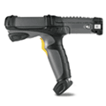
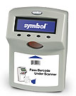
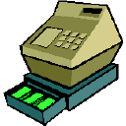




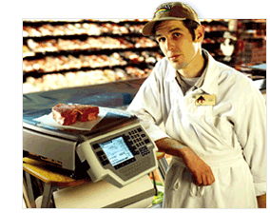

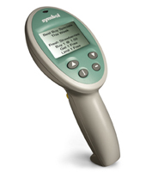
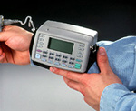
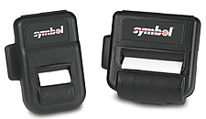
Does my Security choice effect my Hardware choice?
EAP types
What about all the rest ?
PEAP,TTLS,TLS, WPA-EPM
CE
Medical Equipment
VOIP
Test Equipment
Cash Registers
Windows Devices and
CE XScale
Manufacturing Equipment
PALM
DOS
Scales

Slide 15


Risk Management : A Balancing Act
Often Wireless Security becomes a battle between the IT Security Officer who wants the highest security possible. And the Mobile or Portable Data Capture project manager who must balance cost, manageability, user acceptance and mobile requirements.
Security is a trade off between the following.
Cost
Required Security Level
Management
User Acceptance
Mobile Requirements

Slide 16
User Acceptance and Mobile Requirements
Both are often overlooked when dealing with Security on Mobile Capture devices.
Three Examples:
One customer setup his security with three separate logins. This worked fine for users occasionally logging in. But this caused the productivity in his warehouse to go way down, the devices being used didn’t have keyboards.
A second customer had a set requirement that, whenever a laptop roamed, the user had to log back in. Of course this was a disaster when applied to his Mobile SAP Warehouse application.
A third customer had insisted the Radius server, used for authentication, be in England, this worked fine for his portable laptop applications, but when he tried to move this to his manufacturing facilities, he had major issues with roaming.
All of these customers, had security policies that worked fine in a portable environment. But they did not scale to meet the demands of Mobile Applications.

Slide 17
User Acceptance and Mobile Requirements
Union labor contracts may need to be considered.
  Example:
    Worker productivity can not be impaired, if workers are paid by piece produced
    If it is to complicated, they will just refuse to comply.
Training must cover any new security procedures.

Slide 18
Management
Managing security on a group of Wireless laptops and desktops is one thing. But when you move the same security standard to a Mobile Data Computer Environment:
Where devices often go back and forth to repair facilities
Devices are shared among users
It usually involves a high rate of turnover and
temporary help
Devices are often spread among different locations
Who in your company is going to manage the security you choose, on 50, 100, 500, 1000, 10,000+ Mobile Capture devices?

Slide 19

Cost
In most cases, the more security you implement, the Higher the CAPX and OPEX cost will be.
Is Mobile Security at any Cost really necessary?
Its important to discuss your Mobile Security needs with someone who understands the demands of a true Mobile deployment.

Slide 20
Security Check Sheet
EAP - PEAP
Setup a Authentication Server. (Cisco, Microsoft, Funk, Meetinghouse)
Create a Certificate Authority Chain for Server verification.
Determine PEAP – Sub types (MSChapv2, MD5 or Token Card)
Will individual passwords be required on each MU?
Who will manage user name and passwords, and server certificates?
Who will configure and install initial Security Client on the MU.
If a MU goes to repair, who will configure the unit upon return?
How will your Authentication Server be Deployed? Central or distributed deployment. (It could affect roaming.)

Slide 21

What Value can you offer your Customer Concerning Mobile Security?
Mobile Security Evaluation –
    Many customers need help to determine the best security policy.
Initial Mobile Device Loading –
    Loading and setting up initial WEP or WPA-PSK key.
Initial Generation and Setup of Certificates –
    Generate a root CA, Server Certificate and Client certificate’s if used.
Mobile Password and Certificate Management –
    Managing the Passwords and Certificate in a secure manner, as units come and go between repair, facilities or new users are added.
Training

Slide 22

Wireless Switch Security Benefits

Slide 23
Security Concerns with Traditional Access Points
1. Physical Security
    MAC Address List, Radius Information, IP address
    Serial port access
2. Resources
    Limited Memory and Processor Capability
    May limit ability to handle future security protocols
3. Trunk Ports
    ESSID to VLAN mapping requires Trunk ports
    Trunk Ports are more susceptible to attacks
  Multicast / Broadcast Traffic
    NOT contained to VLAN (ESSID to VLAN mapping)

Slide 24
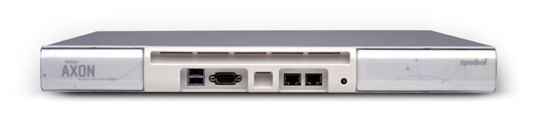
Security Advantage of Symbol’s
Wireless Switch Technology
1. Physically Secure
    No Corporate information on the Access Port
    No serial port access
2. Resources
    More Memory and Processing power
    Supports all EAP types and WPA
    AES hardware ready
3. Trunk Ports
    Trunk Ports are not required for ESSID to VLAN mapping

Slide 25
Security Advantage of Symbol’s
Wireless Switch Technology
4. Virtual Access Ports
    Multicast/Broadcast Contained to each VLAN
    Reduced risk of inter-VLAN hacking
5. Data Tunneling
    All Wireless data is encapsulated within a 802.3 frame
    Harder for an intruder to attack intermediate switches
6. Firewall
    WS5000 - Ability to set Input / Output policies – ACL
    WS2000 - Statefull firewall capability

Slide 26
Security Advantage of Symbol’s
Wireless Switch Technology
7. NAT - WS2000
    Network Address Translation
    Separate Public and Private IP addresses
8. IP Redirection
9. Symbol Specific
    Kerberos KDS Server in WS5000
    KeyGuard

Slide 27
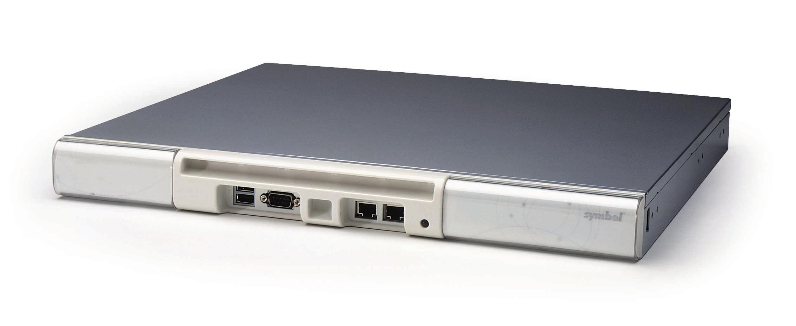
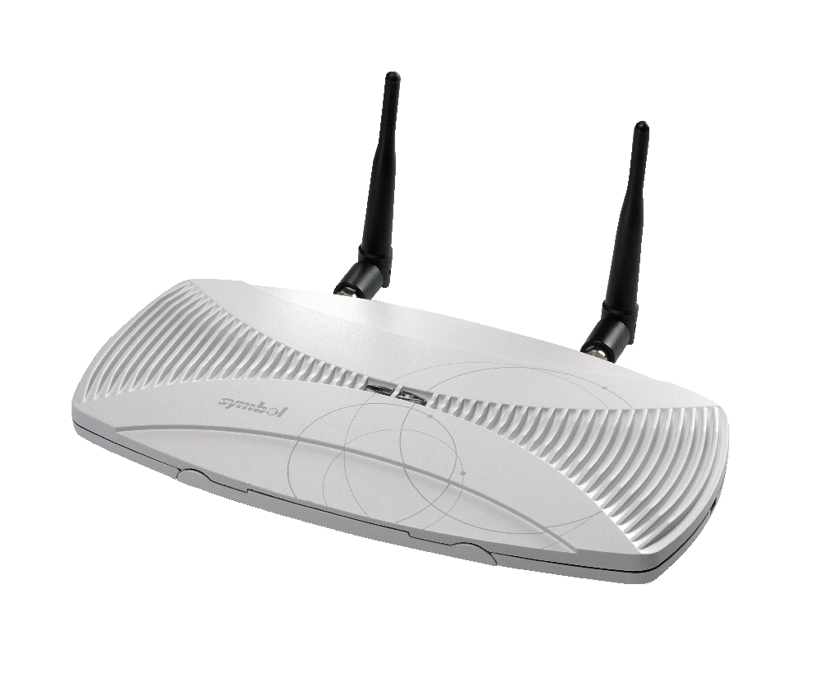
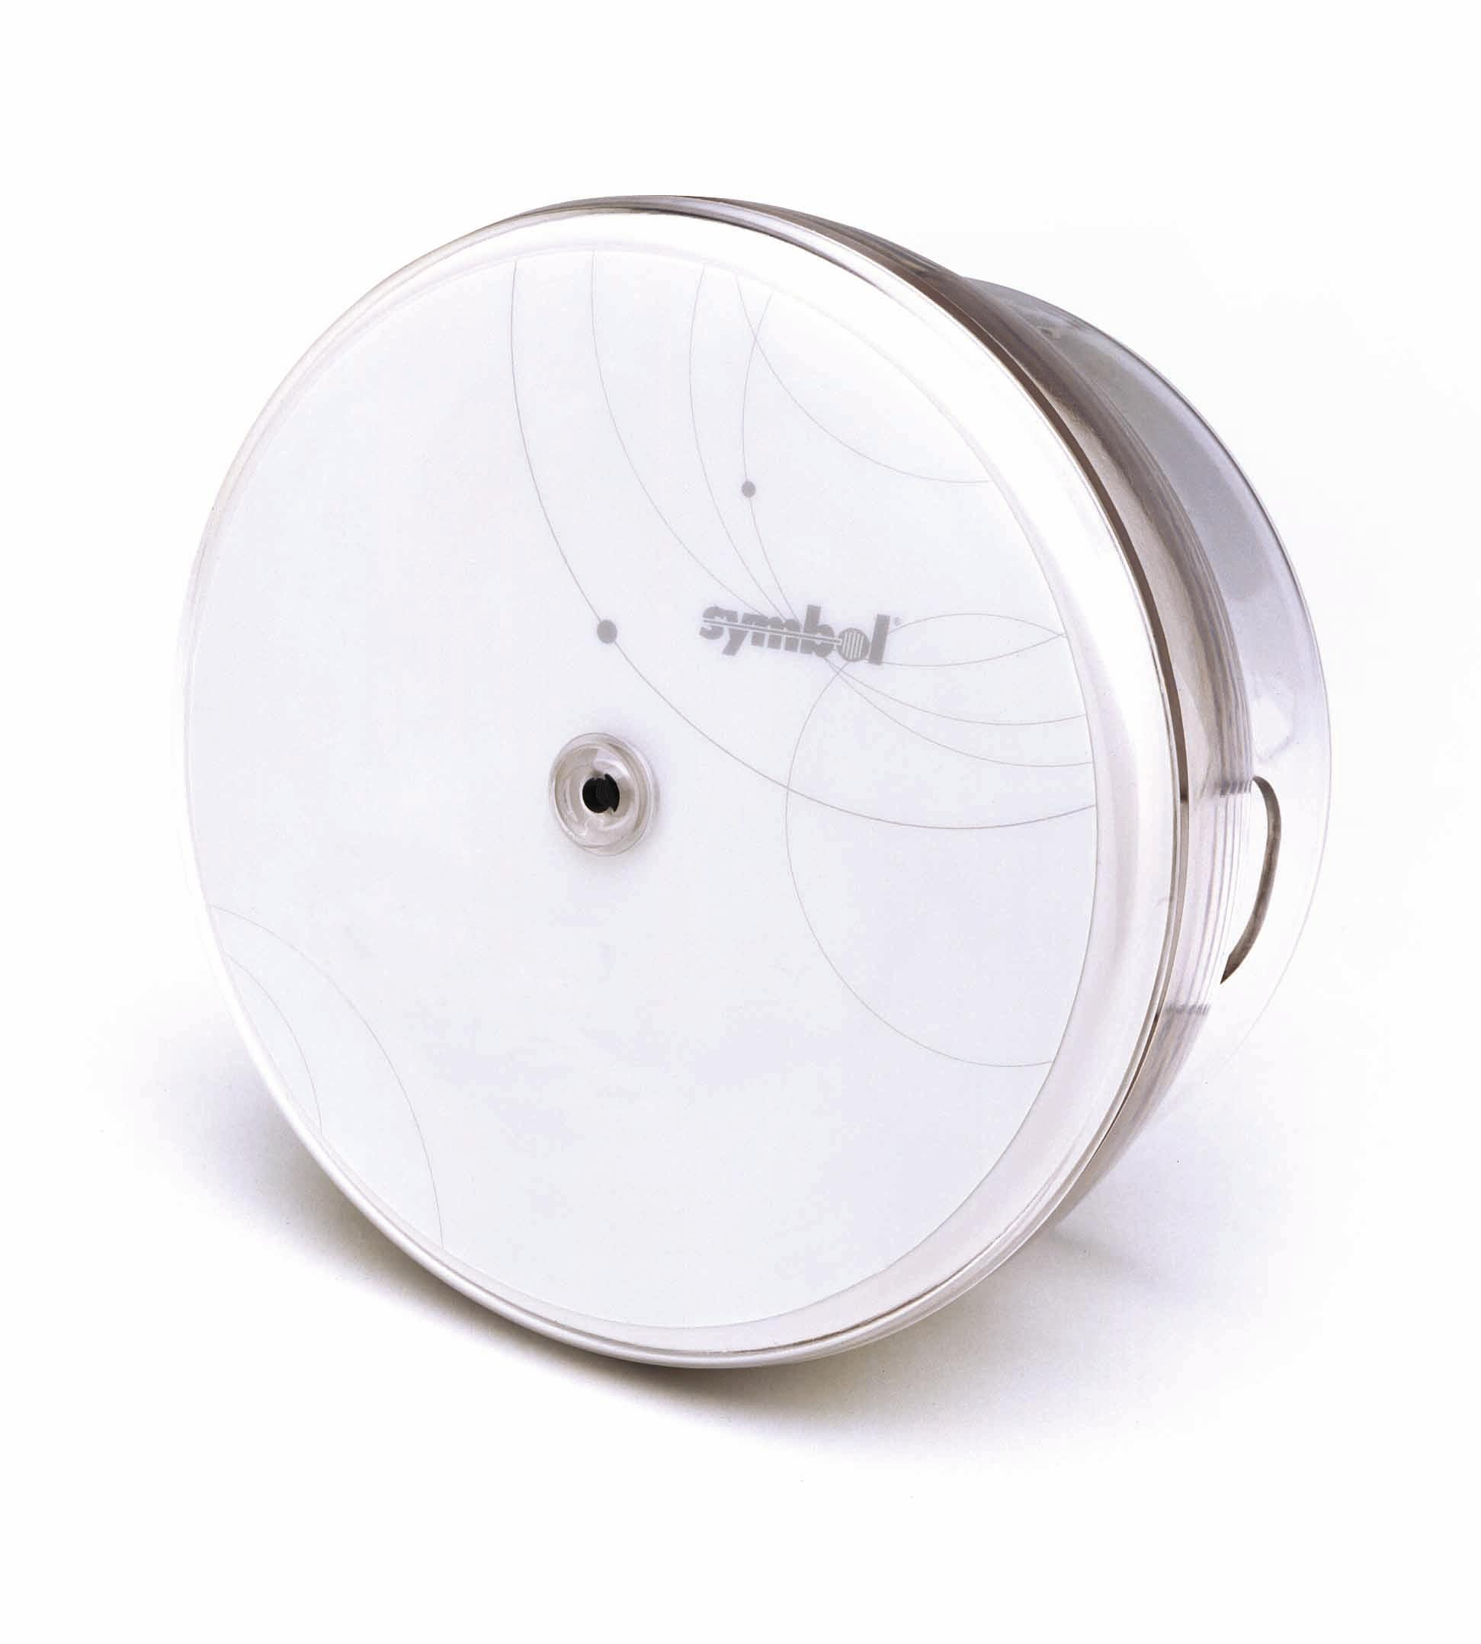
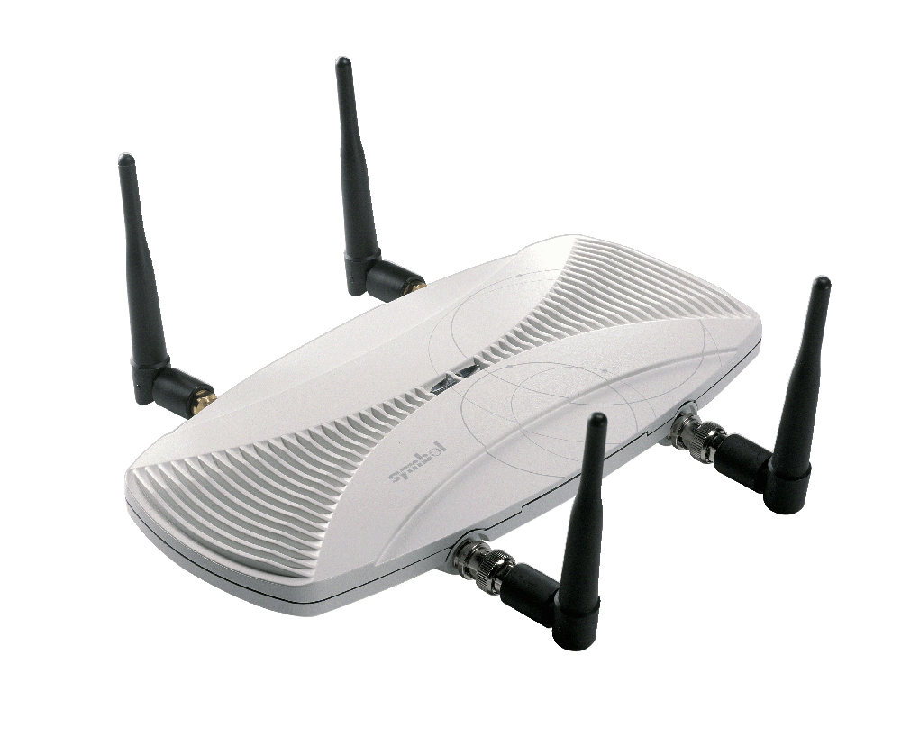
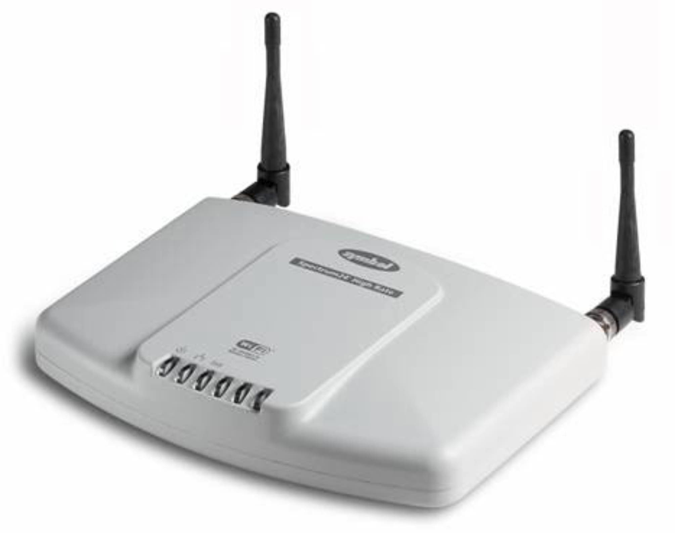
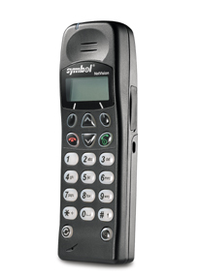
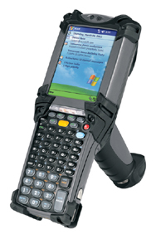
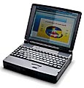
WS-5000 – Robust and Multiple Security Modes
Support for Security Standards
Wi-Fi Protected Access (WPA)
EAP-TLS/802.1X, PEAP
Wireless VPN
802.11i w/AES, when ratified
Additional Policy based input and output filters not found in traditional Access Points
Physical Security
Unlike traditional Access Points, Access Ports do not have a serial port to tap into nor do they contain any security settings (if a hacker steals a traditional Access Point, he/she steals the “keys” to your WLAN).
Mobile Security Enhancements
KeyGuardTM Encryption
Kerberos V5 (RFC 1510)
Wireless VLANs with Multiple ESSIDs and BSSIDs Actually contain your multicast and broadcast traffic to each VLAN
Access Ports do not have an IP address
Multiple Simultaneous Security Schemes
802.11 b…a…g* Access Ports
Voice
Data
WEP
TLS
Open (e.g. for
public access)
PEAP

Slide 28
What Value Can You Offer Your Customer Concerning Wireless Switch Security?
Policy Configuration –
  Allow time to configure and test security policies
Firewall (WS2000) –
  Allow time to configure and test EAP/WPA and Firewall settings
Training

Slide 29



Security using Airbeam Safe

Slide 30
Airbeam Safe VPN
Security Standard - WTLS
Strong Encryption – DES, 3DES, AES (128, 256) NOW
FIPS 140-2 certified
Strong Authentication Mechanisms
X.509 certificates
Windows Domain Username/Password
RADIUS
RSA SecurID
Smartcard/CAC card

Slide 31
Airbeam Safe VPN
Support for Wireless PKI
    Certificate Manager
Personal Firewall protection on the Client
    Only data that has been properly encrypted by the Airbeam Safe Server is accepted.
Firewall included on Server
Most Device Types Supported
    Windows, Windows CE, and Symbol / Telxon DOS Mobile Devices

Slide 32
What Value Can You Offer Your Customer Concerning Airbeam Safe?
Initial Setup of VPN Server
Certificate Installation on Mobile unit
Certificate and Password Management

Slide 33
Security Check Sheet
WEP or WPA-PSK
WEP Key Deployment
WEP key Management
How will initial WEP keys get deployed on all devices?
Who will have WEP key access?
Will all locations have the same WEP key?
How will units coming back from repair be handled?
Will all units from all locations go to a central site for configuration or will someone at each site be responsible?

Slide 34
Security Check Sheet
*Clients may require additional software to enable all these features.
EAP - PEAP
Authentication Server
User Authentication
MU Management
Choose PEAP Subtype
How will initial software and Certificate Authority get on each unit?
Cisco, Microsoft, Funk, Meetinghouse
MD5, MSChapv2, Token Card
Create Certificate Authority Chain.
How will units coming back from repair be handled?
Will you use individual Username and Passwords?
Will AS deployment be central or distributed?
Who will handle Password & Server Certificate Management?
Who will Manage AS?

Slide 35
Symbol Mobile Unit Security

Slide 36
WLAN Security – Available Options Example
AP 4131
WS 5000
SymbolPC Card 3.92
CB2000
PPT8100
XS 2003
PPT 8800
.Net 4.2
MC9000
WM2003
MC9000
.NET 4.2
WEP
Yes
Yes
Yes
Yes
Yes
Yes
Yes
Yes
KeyGuard
Yes
Yes
Yes
No
Yes
Yes
Yes
Yes
EAP-TLS
Yes
Yes
Yes
No
3pty
SW
No
Yes
Yes
WPA-EPM
Yes
Yes
Yes
No
3.93
3.93
3.93
3.93
LEAP
No
No
No
No
Yes
Yes
Yes
Yes
WPA-PSK
No
Yes
Yes
No
Yes
Yes
Yes
Yes
PEAP/MS
No
Yes
Yes
No
Yes
Yes
Yes
Yes
ASVPN
Yes
Yes
Yes
No
No
No
Soon
Soon
AES
No
HW
No
No
No
No
w/ABSVPN
w/ABS VPN

Slide 37
Security Quick Reference
 | EAP-TLS | PEAP | EAP-TTLS | Airbeam Safe VPN
Security Solution | Standard Based | Standard Based | Standard Based | Standard Based
Certificates -Client | Yes | No | No | Yes – but not req.
Certificates - Server | Yes | Yes | Yes | Yes
Client PW Authentication | N/A | Yes | Yes | Yes
Credential Security | Strong | Strong | Strong | Strong
Dynamic Key Exchange | Yes | Yes | Yes | Yes
Mutual Authentication | Yes | Yes | Yes | Yes
Windows Devices Only | Yes | Yes | Yes | No

Slide 38
Summary

Slide 39


Wireless Security Tips
Wireless Security is still in the development stage expect changes.
Before any Wireless Network decision, you should completely understand how it might effect all your current and future wireless projects.
Be sure your chosen security method, available on one device type, will be available on other devices required by your corporate divisions.
Security that works great in your portable environment, might not scale well in a mobile environment.
If your project involves mobile devices, you should choose a partner that understands Mobility and the unique requirements for security..
Don’t get boxed into a propriety solution.

Slide 40

Questions?

